Slide 1
Risk analysis
Credit eda case study

Slide 2
objective
This case study aims to identify patterns which indicate if a client has difficulty paying their installments which may be used for taking actions such as denying the loan, reducing the amount of loan, lending (to risky applicants) at a higher interest rate, etc.
This will ensure that the consumers capable of repaying the loan are not rejected. Identification of such applicants using EDA is the aim of this case study.
The company wants to understand the driving factors (or driver variables) behind loan default, i.e. the variables which are strong indicators of default. The company can utilise this knowledge for its portfolio and risk assessment.

Slide 3
Our analysis
“Analysis is the art of creation through destruction.” ― P.S. Baber, Cassie Draws the Universe

Slide 4
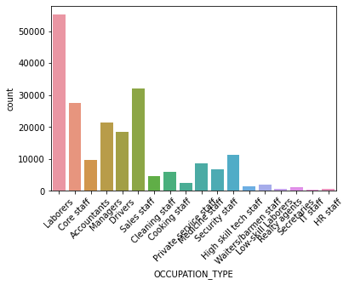
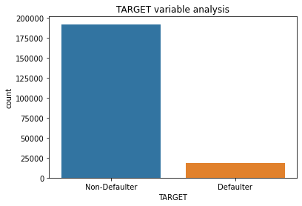
Data analysis
Frequency of Occupation
The highest number of people who apply for loans are laborers.
HR staff has to lowest number of loans applicatioin
For loan applicants the repayers(non-defaulter) are significantly higher than the defaulters.
So if we give out loans we have a higher chances of getting out money back.

Slide 5
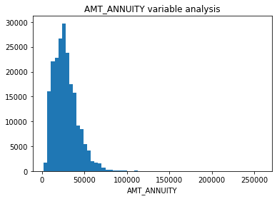
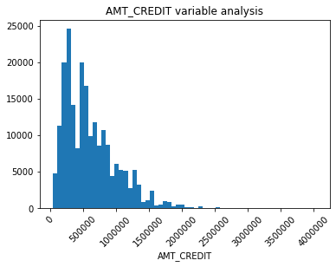
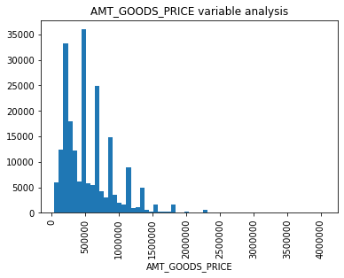

Slide 6
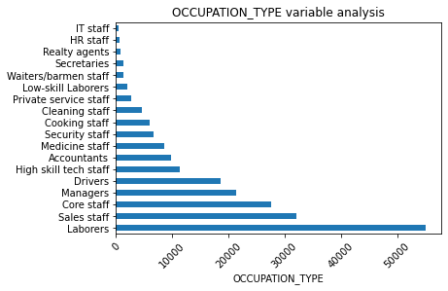
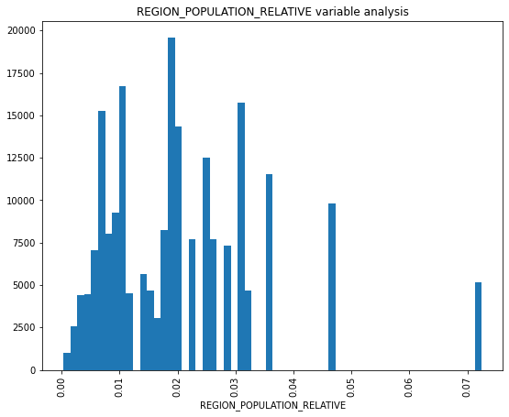
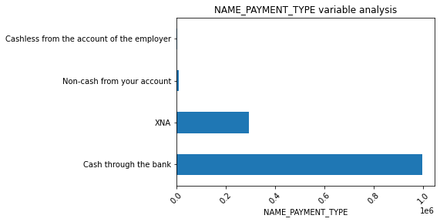
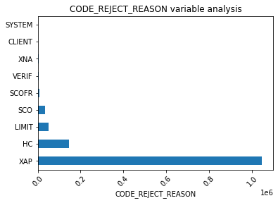

Slide 7
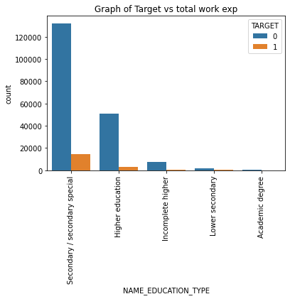
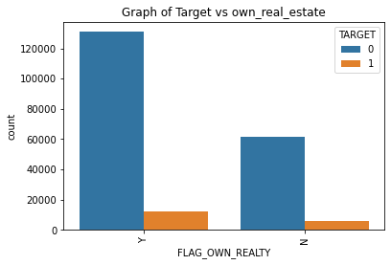
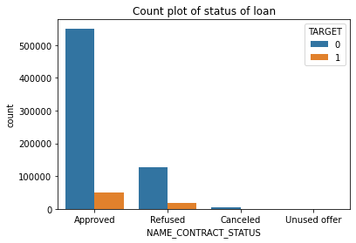
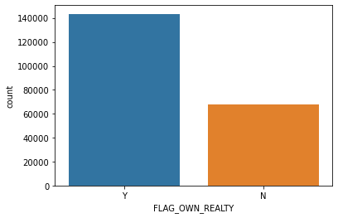

Slide 8
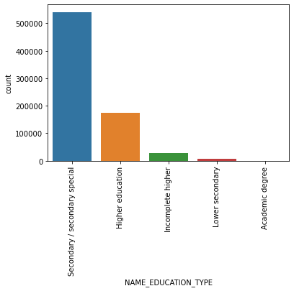
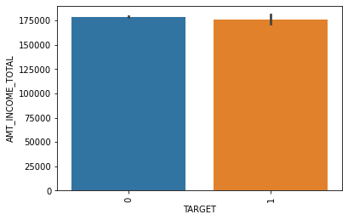
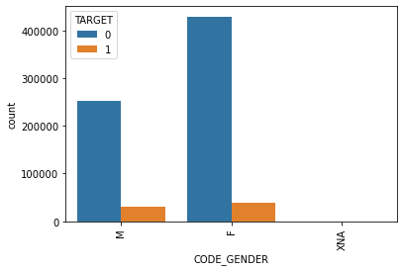
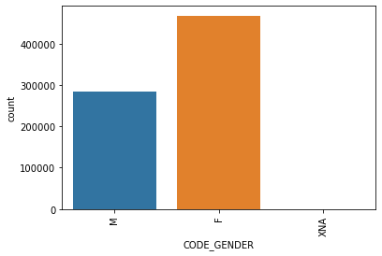

Slide 9
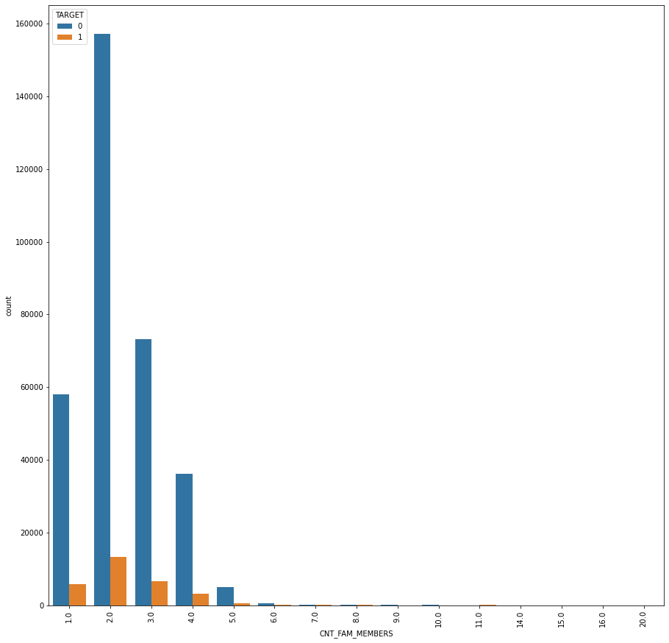
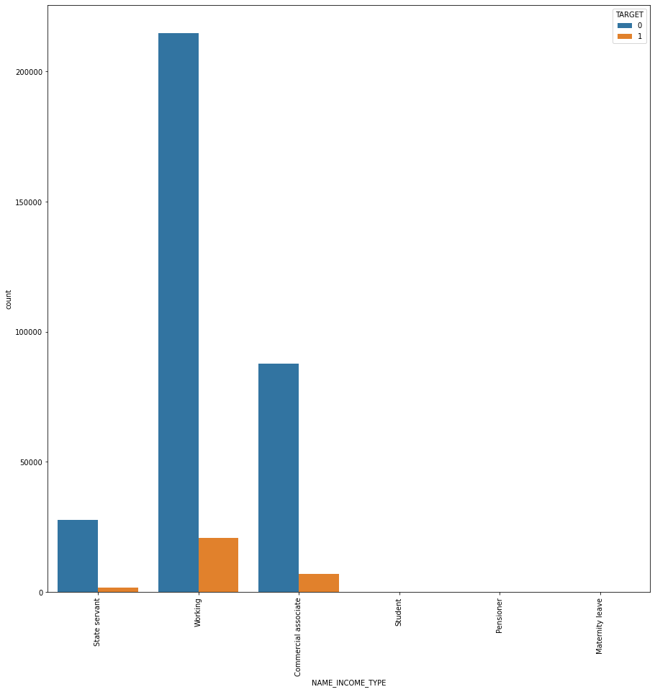

Slide 10
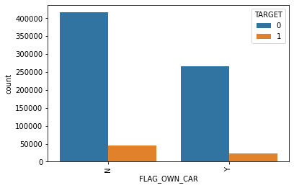
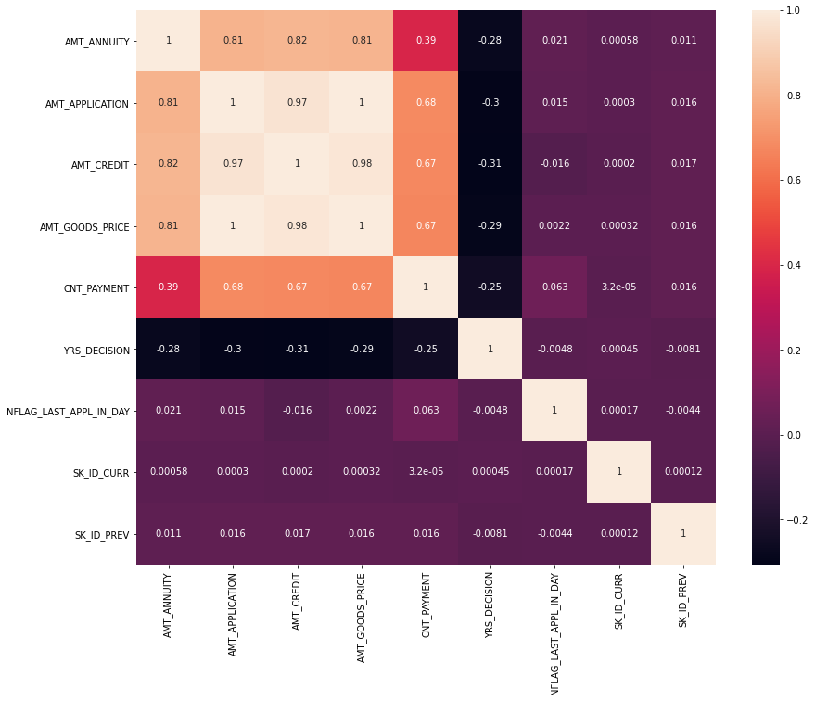
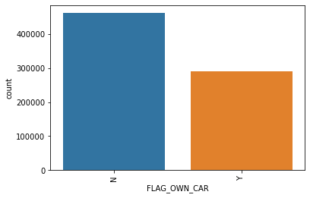

Slide 11
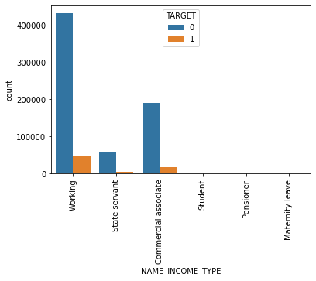
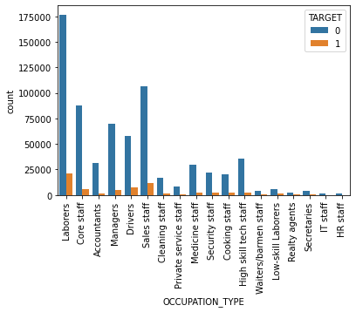
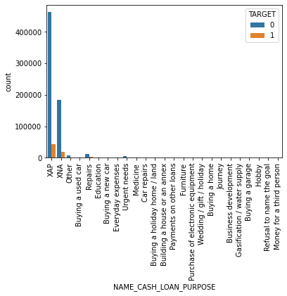

Slide 12
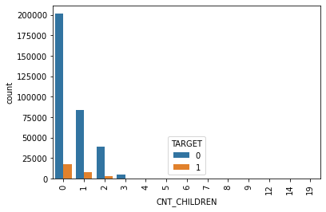
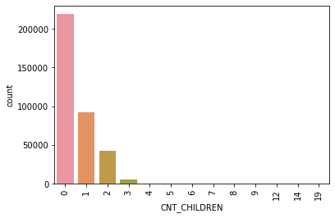
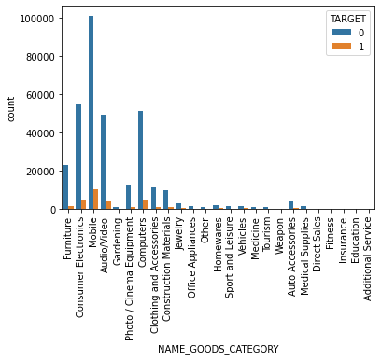

Slide 13
CONCLUSION
Decisive Factor whether an applicant will be Repayer
NAME_EDUCATION_TYPE: Academic degree has less defaults.
ORGANIZATION_TYPE: Clients with Trade Type 4 and 5 and Industry type 8 etc have repayed the loans.
DAYS_EMPLOYED: Clients with 40+ year experience having less than 1% default rate.
AMT_INCOME_TOTAL: Applicant with higher income repay loans.
CNT_CHILDREN: People with zero to two children repay loans.
NAME_INCOME_TYPE: Student and Businessmen repay loans.
CNT_FAM_MEMBERS: People with less family members default less

Slide 14
Decisive Factor whether an applicant will be defaulter
CODE_GENDER: Men default more as compared to women
NAME_FAMILY_STATUS : People who have civil marriage or who are single default a lot.
NAME_EDUCATION_TYPE: People with Lower Secondary & Secondary education default more.
NAME_INCOME_TYPE: Clients who are working, commercial associate default a lot.
OCCUPATION_TYPE: Low-skill Laborers, Drivers and Waiters/barmen staff, Security staff, Laborers and Cooking staff default.
ORGANIZATION_TYPE: Self-employed people have relative high defaulting rate
CNT_CHILDREN & CNT_FAM_MEMBERS: people with relatively more no of family members & children default more.
AMT_GOODS_PRICE: When the credit amount rises, default rate rises.

Slide 15


OUR TEAM
ADNAN dodmani
Shivanshi tiwari

